Slide 1
Consumer Aware Warehouse Management
SDMay20-25
Advisor: Goce Trajcevski
Client: Jimmy Paul, Crafty LLC. CTO
Team: Lindsey Sleeth, Omair Ijaz, Andrew Smith, Sam Stifter, Jameel Kelley, Elijah Buscho
http://sdmay20-25.sd.ece.iastate.edu/
Notes:
Hi we are SDMay20-25 and we are working on Consumer Aware Warehouse Management. [everyone introduce themselves]

Slide 2
Client Background
Crafty LLC helps companies enhance their employees life at work by providing offices with food, beverage, and event management
SDMay20-25, Consumer Aware Warehouse Management
Notes:
To start us off today, I’ll be providing some background on our client. Our team is working with Chicago based company Crafty. Crafty’s mission is to help companies enhance their employees life at work by providing offices with food, beverage, and event management.

Slide 3
Project Motivation
$600,000 Annually
Missed Revenue for
20,000 Missed Items
$100,630 Annually
Lost Value for
15,356 Expired Items
3 Full-Time Employees
Dedicating
50% of Time to Ordering
Notes:
Crafty has provided these statistics to demonstrate several of their pain points which motivate how they can improve their business. The largest areas for improvement are reducing missed sales for insufficient inventory, waste of expired product, and redirecting labor efforts which have been proven to be erroneous and time consuming.

Slide 4
Project Vision
Price Trends
Distributor Schedules
Client Trends
Missed Sales
Crafty desires a forecasting algorithm for inventory management that automates reordering for warehouse stock
Warehouse Space
Seasons
Expiration Dates
Historical Ordering Data
New Customer Orders
Inventory Thresholds
SDMay20-25, Consumer Aware Warehouse Management
Notes:
In response to these areas of improvement, Crafty desires a forecasting algorithm that is going to help automate reordering by determining which products should be reordered. Crafty has a current solution that takes into consideration historical ordering data which is how much of each product is consumed over a period of time, distributor schedule and lead time, missed sales, and client inventory thresholds. Our team is looking to incorporate additional variables, with the major emphasis being on needs of new customers, client trends, warehouse space, and product expiration dates.

Slide 5
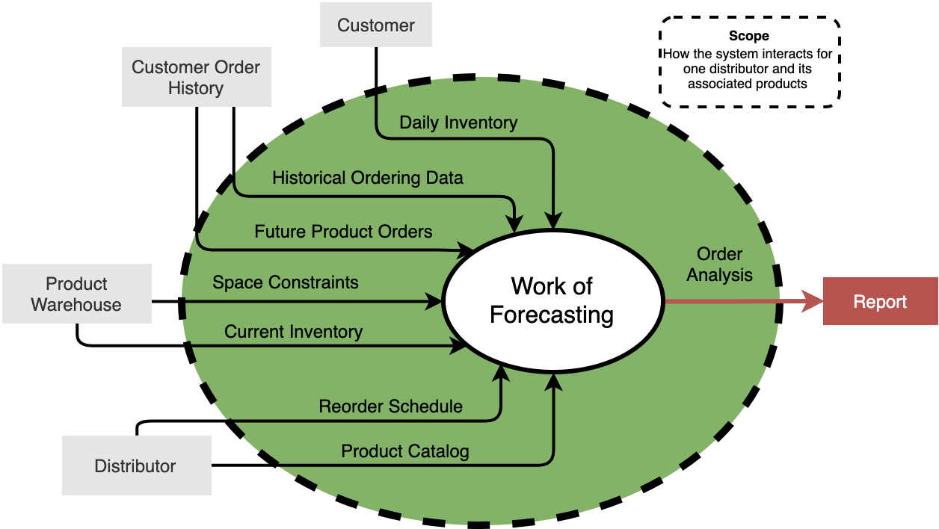
Conceptual Sketch
SDMay20-25, Consumer Aware Warehouse Management
Notes:
Based on the input variables shown previously, we have created a context diagram to provide scope for the project and show how the data flows to and from the adjacent systems, which are the categories of input variables that directly influence the work of forecasting. (systems, people, or work areas that the WoF depends on and produce for/influences). The scope here is how the system interacts for one selected distributor and its associated products. You can see that the forecasting algorithm will take into consideration input variables from customer order history which includes future product orders and historical ordering data, product warehouse data such as space constraints and current inventory, the daily inventory of each customer, and distributor information such as the products that they have available in the catalog which will account for seasonal items and pricing and the reorder schedule which will tell us how often we can order from the distributor and how long it takes for the product to be delivered. All of these input variables will be pulled from the Crafty database and be input into the forecasting algorithm to generate a report of what Crafty should order from that distributor.
As we see in the diagram, we understand Crafty through three users interacting with multiple, connected systems.
The Distributor takes care of placing orders, updating product catalogs, and updating the order availability schedule.
The Client takes care of updating their own inventory
The Crafty Team ships orders
We see our project fitting into the use case of Crafty though providing prediction analytics for the Crafty team.
...

Slide 6
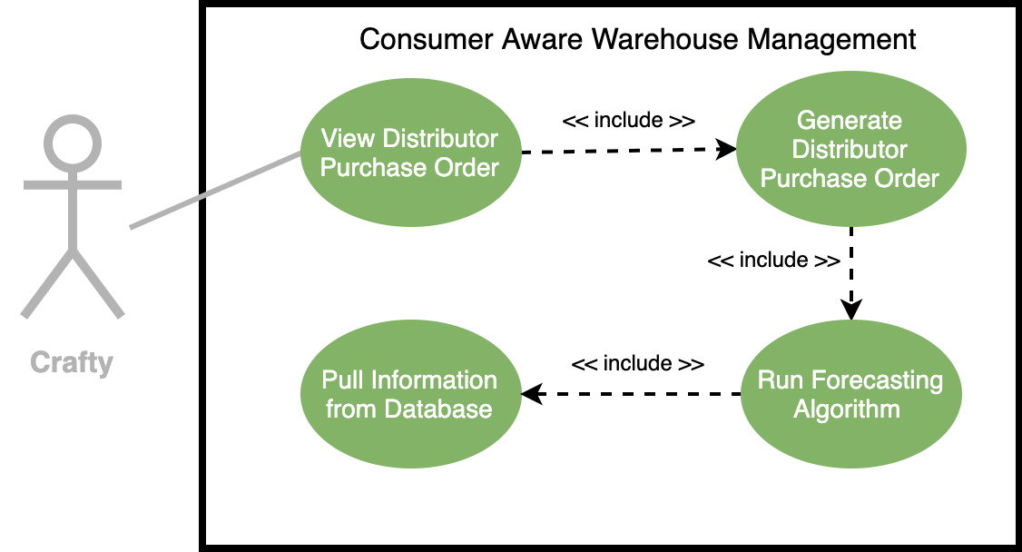
Conceptual Design Diagram - Use Case Diagram
SDMay20-25, Consumer Aware Warehouse Management
Notes:
-walk through diagram, point out:
-what we are doing
-where/how our system interacts Crafty
-special events, how will they be entered? Will we facilitate that or will Crafty?

Slide 7
Functional Requirements
Consider Future Product Needs
Take Input From Crafty Database for Distributor Purchase Order
Predict Optimal Product Orders
Create User Interface for Modification of Product Orders
Events and New Clients
DB Format
Order History, Stock, Space, +
Manual Adjustments and View
SDMay20-25, Consumer Aware Warehouse Management
Notes:
Take data from the Crafty database as input in creating a distributor purchase order
This requirement makes it such that SDMay20-25 software solution will be tied to complying with the format of the current data stored in Crafty’s database.
For each distributor, make predictions about optimal ordering to maintain product warehouse stock for individual goods provided by that distributor based on
previous product orders
current product warehouse stock
current product warehouse space.
As seen in figure 1.2.1.2, the adjacent systems being worked with allow the input of the previous product orders, current product warehouse stock, current product warehouse space. These system inputs will allow the software solution to generate a distributor purchase order output.
Consider future product ordering, which includes new onboarding of Crafty clients and current Crafty clients with needs outside of contract as input when generating orders to be placed to distributors.
Crafty needs a tool that will allow them to account for more than just happy path use cases. Thus the software system needs to have an inbuilt input for special or exception events that would otherwise not be accounted for. This can be seen in the figure 1.2.1.3 as “Order Generation with Special Events.”
Have a user interface to allow Crafty to modify orders to be placed.
The Crafty procurement team needs a way to interface with the system tool to make manual adjustments and view the distributor product ordering report. This is documented in figure 1.2.1.3 as the “View Product Order Table” that is an inclusion use case of the Crafty procurement team.
Put these in a logical order in terms of how the system may process these things

Slide 8
Non-Functional
Requirements
Distributor Purchase Order Stock Keeping Units (SKUs)
(1200 SKUs)
Report Generation in a Timely Manner
(< 2 min 90% of the time)
SDMay20-25, Consumer Aware Warehouse Management
Notes:
Handle approximately 1200 SKUs a day
The system in place that Crafty is using is able to handle this number of SKUs in a day. Due to this, the software solution must be able to handle this many skus a day at a minimum.
Generate a report on demand that will take less than two minute 90% of the time and will take less than five minutes the remainder of the time in order to satisfy the need for on-demand ordering analysis.
The current Crafty system in place for doing ordering analysis was observed to take less than a minute to generate its results and display it to the view. It is important that the SDMay20-25 solution be no worse than the current system in place in terms of performance. In figure 1.2.1.3, this product use case can be seen as the “View Product Order Table” use case.
***Mention SECURITY ***
Jimmy: what is 90% of the time mean?
Explain that every time they are about to place an order they have to run this algorithm to generate the report

Slide 9
Project Plan - Schedule / Milestones
September 30
October 31
November 30
January 31
February 29
March 31
April 30
Finalized Project Plans
Finalized Project Architecture and Initial Tech Stack
Methodology Selection and Tools
Testing Framework
Alpha Version of the Software
Unit Testing, Validation, Beta
Integration Testing, Finalize Solution, Report
SDMay20-25, Consumer Aware Warehouse Management
Notes:
Transition: From our requirements we created these monthly milestones early on into the semester.
These milestones are based off our development process as our first semester was spent on requirement analysis and design and our second semester will include implementation and testing.
Currently we have completed our november milestone which was finalizing our tools for the Software Solution.
Our next semester entails implementation of our proposed solution. Testing into Alpha then Beta then Final software solution

Slide 10
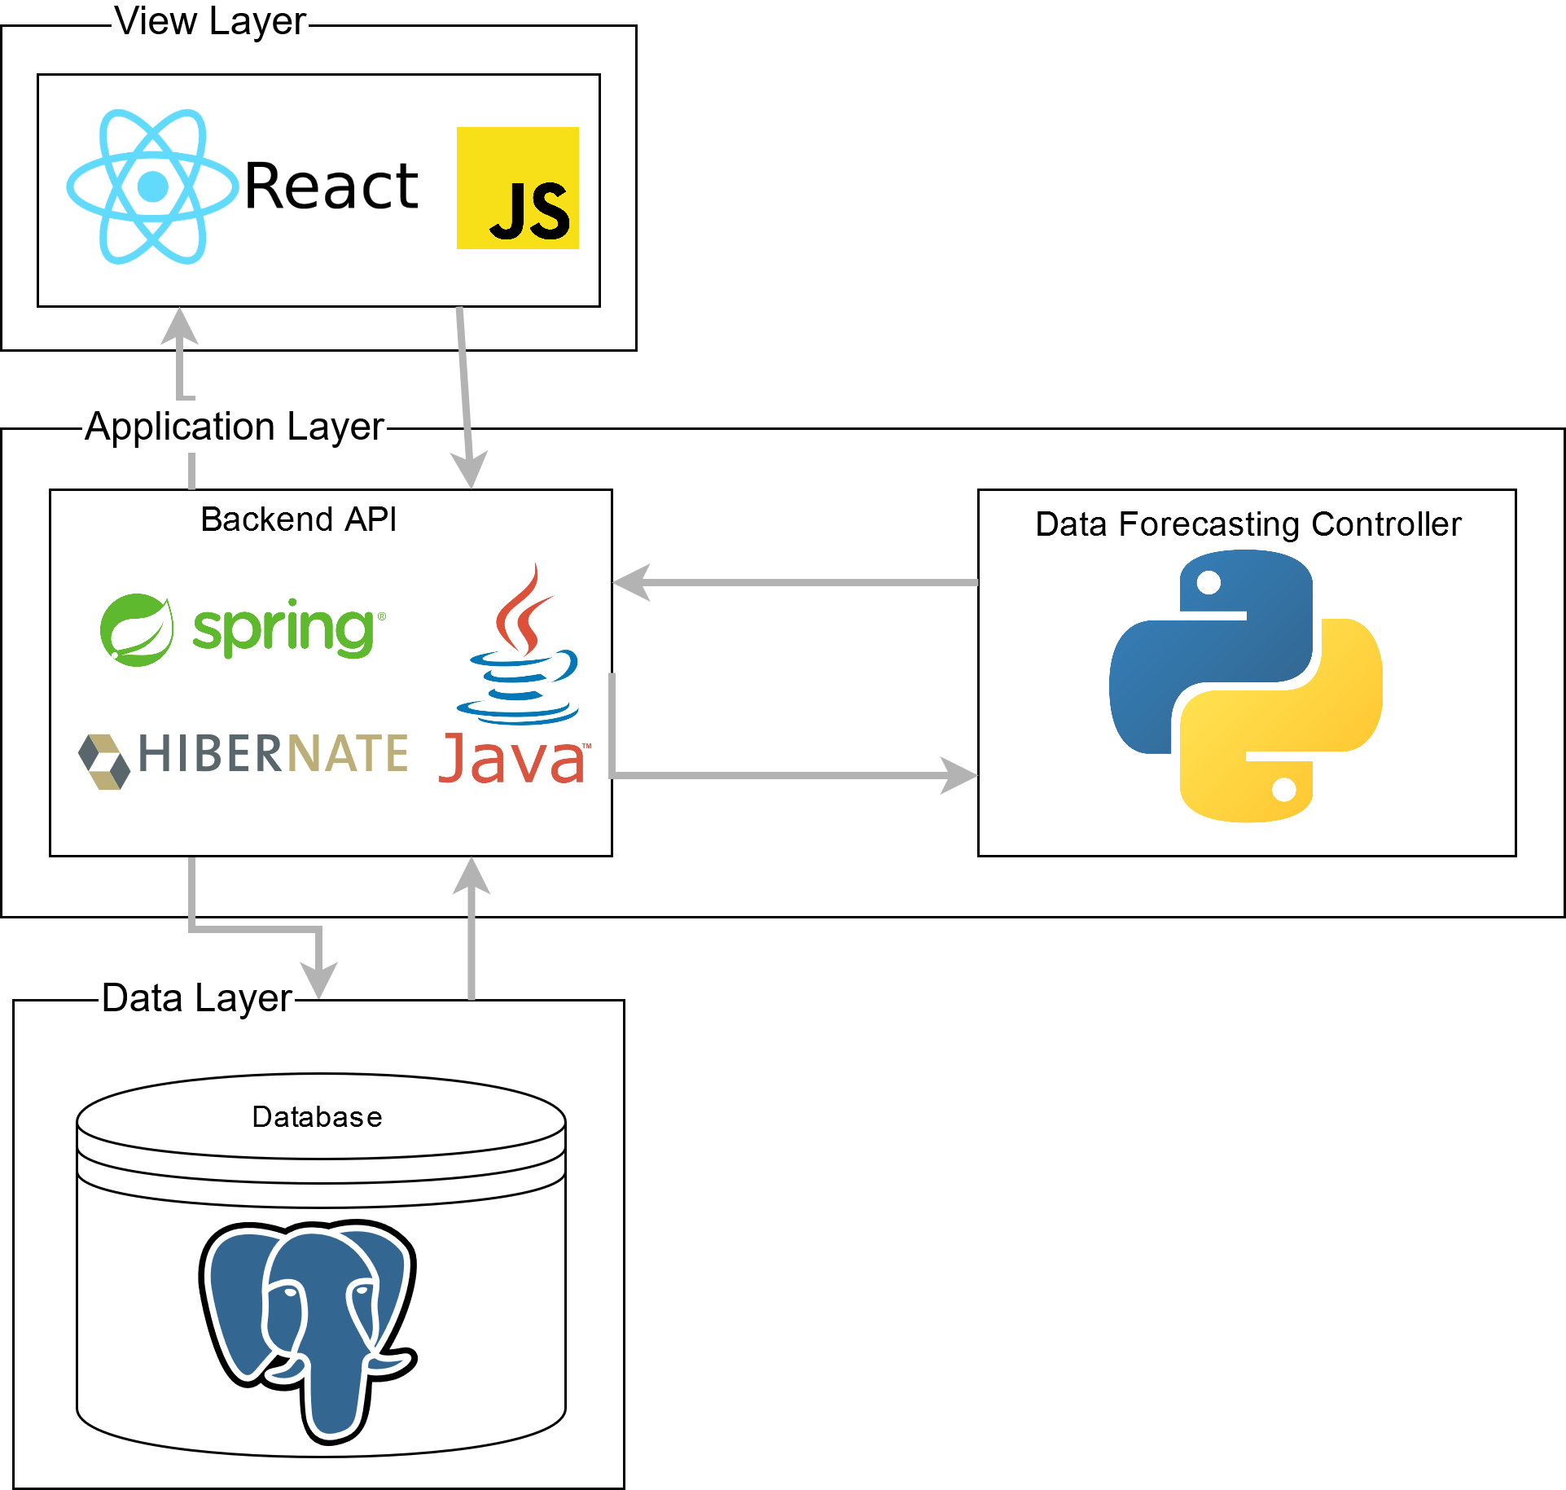
System
Design
SDMay20-25, Consumer Aware Warehouse Management
Notes:
Our tech stack will have JavaScript with React framework on the front end; on the backend, we will be using Java with a Spring and Hibernate framework with Python Pandas for the machine learning algorithm; and for the database, we will be using PostgreSQL. We choose JavaScript and React because of the knowledge our team members have with both and the amount of online resources available to support and help. We choose Java with Spring and Hibernate because of the knowledge we possess in these software system and again the online support. We choose Python Pandas for our machine learning algorithm because we are comfortable with Python and need the capabilities that Pandas offers. Pandas also has a less of a learning curve compared to other libraries like R. We choose PostgreSQL because our client uses PostgreSQL so we can more easily integrate their data into our database. The language is also very similar to MySQL which we have experience with.

Slide 11
Project Plan - Tasks
Project Planning Tasks
Everyone
Assigned To
Frontend Tasks
Frontend Team
(EB, JK, LS)
Assigned To
Backend Tasks
Backend Team
(AS, OI, SS)
Assigned To
SDMay20-25, Consumer Aware Warehouse Management
Notes:
Transition: Once a our milestones were set in place we could then accurate generate tasks.
Tasks were split into three categories: requirements & project planning, frontend, backend
As stated previously, the big focus was project planning and that involved the entire group
After we completed our Proposed Design (as seen in the slide previously) we split of into two teams frontend consisting of Elijah, Jameel, and Lindsey and backend consisting of Sam, Andrew and myself
It is important that our tasks were completed synchronously meaning that frontend and backend are roughly on the same page
Make note: that frontend will shift merge into backend

Slide 12
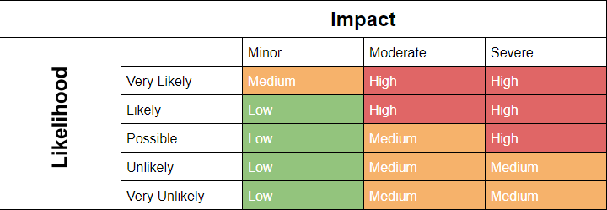
Project Plan - Risks
Inaccurate results
Results not clearly understood
Steep learning curve
SDMay20-25, Consumer Aware Warehouse Management
Notes:
Transition: One of the first tasks worked on early in our planning phase was assessing the potential risks when working on this project.
Here is a risk matrix that our group created. A risk matrix categorized a risk based on its likelihood and the impact it will have. On this slide, there are three risks we have identified as a “high” risk to our project
The first risk deals with inaccurate results. Crafty themselves has a solution in place, but they would like one that is more reliable and can save them more money in the long run. This risk occurs when our solution does not perform better than Crafty’s
The second risk is that the results are not clearly understood. Our software solution outputs a distributor purchase order, and it is vital that Crafty understands why our algorithm behaves the way it does.
The final high risk is the steep learning curve. Our project introduces a lot of technologies that we have not worked on previously, so it is crucial to our success that we choose technology that is well documented.
The mitigation plan consists of:
Jimmy: worst thing is that can come out of this is an algorthim that seems correct but is reporting the wrong thing. How will we prove correctness? Include a bullet under mitigation plan

Slide 13
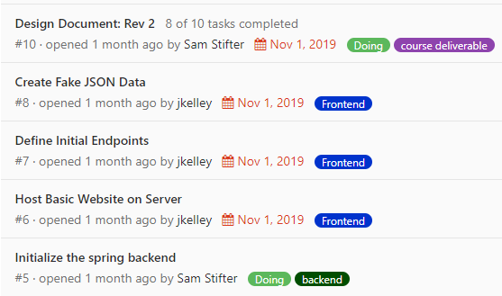
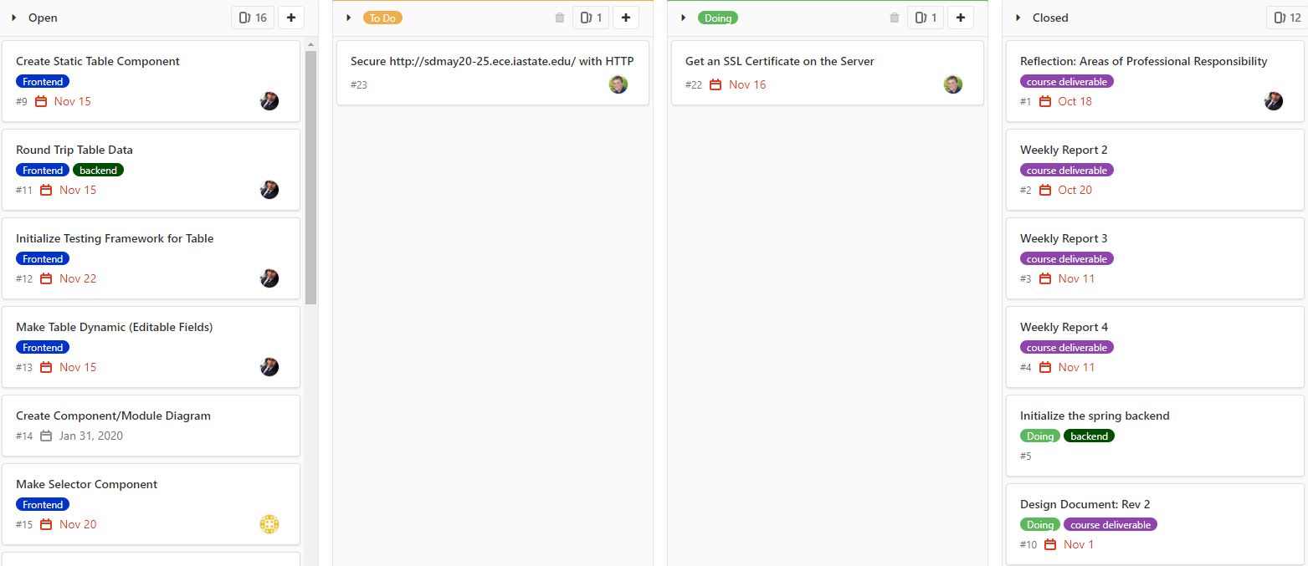
Project Plan - Progress Metrics
SDMay20-25, Consumer Aware Warehouse Management
Notes:
Transition: To track our progress through our tasks we will use GitLab issues.
Each task identified will be translated into an issue in GitLab
Issues in gitlab are well organized and include a due date, assignees and are assigned to a milestone
Gitlab issues can also be viewed in a board view which helps us visualize which issues are open, closed, doing and done
Slack is used as informal communication between the team, any relevant information from slack can be copied to gitlab
TODO->add a better image

Slide 14
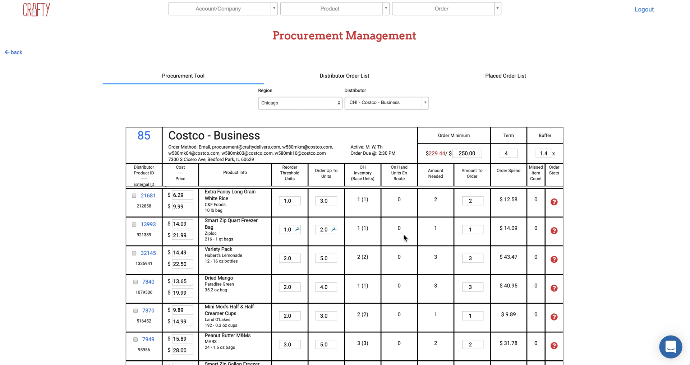
Crafty’s System
1
2
3
4
Notes:
TODO: animate this slide

Slide 15
Prototype Implementations
SDMay20-25, Consumer Aware Warehouse Management
Notes:
Showcase our UI
Discuss Results
Discuss Querying & Setup So Far

Slide 16
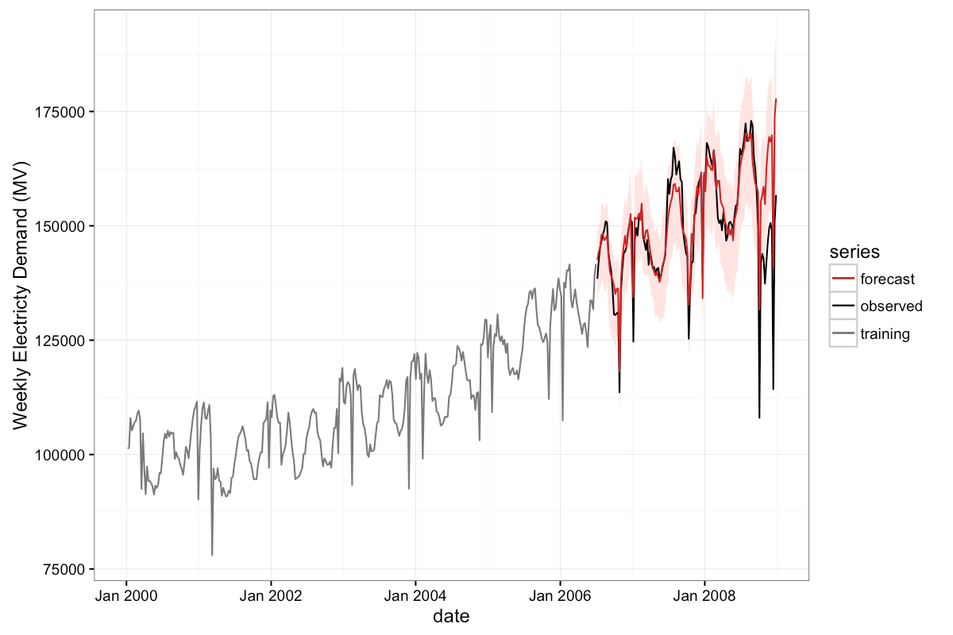
Algorithm Approaches
SDMay20-25, Consumer Aware Warehouse Management

Slide 17
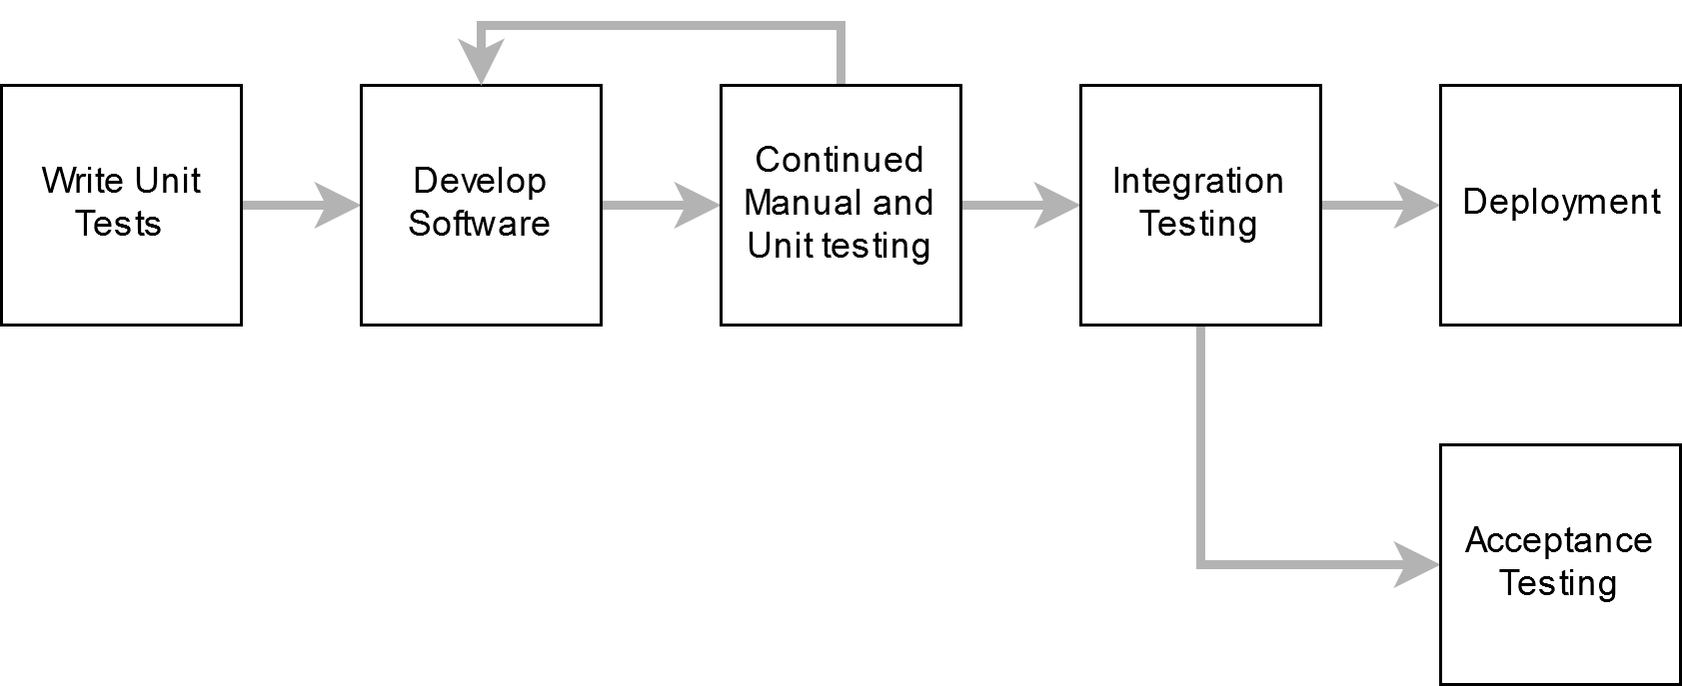
Test Plan
SDMay20-25, Consumer Aware Warehouse Management

Slide 18
Test Plan
Acceptance Testing
These factors help us identify how well the solution is performing
Demonstrate to the Client
Verify Predictions Against Human Orders
Show Crafty incremental progress on the app
Compare what a human would have ordered with the same information
Validate Algorithm Reasoning
Perform Predictions on Past Time Frames
Check reasoning algorithm provides for decisions
Split data into learning and evaluation sets
SDMay20-25, Consumer Aware Warehouse Management

Slide 19
Project Roadmap
Accomplishments
Planning
Requirements Elicitation
Initial Research
Project Plan
Proof of Concept
Frontend
Backend
Querying Crafty’s Database
Future Plans
Development
Testing
Prototyping
Continue Research
Talk to Client
SDMay20-25, Consumer Aware Warehouse Management
Notes:
So far we have completed our requirements elicitation, initial research, and our project plan. We also have a proof of concept of the system architecture including preliminary integration of a frontend and a backend server with Crafty’s DB.
So essentially we have planning and scaffolding done with development and testing to come.
Where we are in the schedule is more of what have we done, show that diagram from earlier on here if it is helpful

Slide 20
Thank you!
Questions?

Slide 21
Existing Approaches 1 (Learning Based Approach)
Input Variables
Past Sales
Weather
Travel Time of Product
Advantages
Better Prediction of Demand
Lowers Missed Sales
Disadvantages
Amount of Resources
Relation to Our Solution
Past Sales Data
Shipping Time
Differentiation From Our Solution
Too Many Input Variables
SDMay20-25, Consumer Aware Warehouse Management
Notes:
During research a couple solutions were found on the market. We saw two endpoints of products available. A machine or deep learning approach, that is being used by Walmart, that takes everything that could affect the sales of a product from past sales to weather like if it’s going to be cloudy steaks sell more than hamburgers. It also takes into consideration the time it takes for a product to arrive and the store. Advantages for this type of system is that it is efficient because it would better predict the demand of a product and make missed sales lower. Disadvantages of this system is the amount of resources it takes to build and maintain it. This relates our solution because it takes into consideration past sales data and the time it takes to get the product to the product warehouse. It is different from our solution because the above solution takes in more factors like weather.

Slide 22
Existing Approaches 2 (Regression Based Approach)
Input Variables
Past Sales
Seasonal Changes
Advantages
Little Amount of Resources
Disadvantages
Can’t Handle Spikes in Demand
Doesn’t Figure in Shipping Time
Relation to Our Solution
Past Sales Data
Differentiation From Our Solution
Doesn’t Figure in Shipping Time
SDMay20-25, Consumer Aware Warehouse Management
Notes:
On the other end was a simple Excel linear regression approach, where it can predict the demand of a product based on past sales and seasonal changes. Advantages to this is system is the low amount of resources to maintain and build. The disadvantages to this system are that it doesn’t take into consideration spikes in demand due to factors that aren’t based on past sales, such as weather, and it doesn’t figure in the time it takes to ship a product. This relates to our solution because it takes into consideration past data. It differs from our solution because the above solution doesn’t take into consideration the shipping time to get the product to the product warehouse.

Slide 23
TODO: Slides to add after the pres for qna
Omair: Gantt chart, Tasks for semester 2, an image of the iterative process

Slide 24
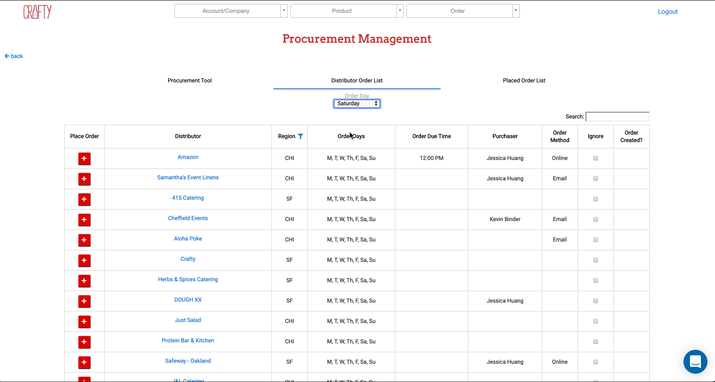
Distributor Order List

Slide 25
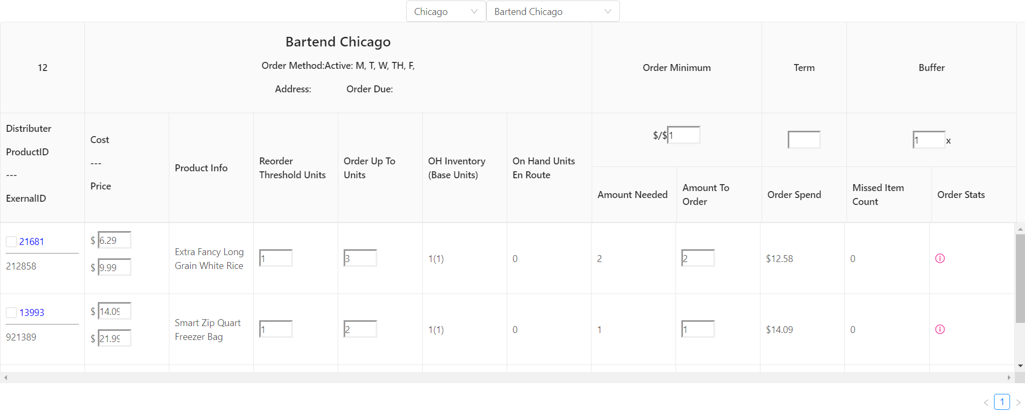
Implementation

Slide 26
